Slide 1
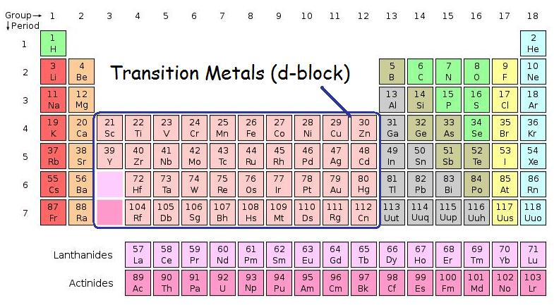
presented by: Michael Morse, University of Utah morse@chem.utah.edu PowerPoints of all of my presentations to this group are available at: https://chem.utah.edu/directory/morse/research-group/index.php Just click on A/P Chemistry Powerpoints and you can download and use them as you like.
Transition Metals (the d-block)
The f-block elements are sometimes called the “inner transition metals”

Slide 2
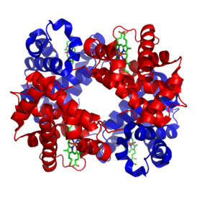
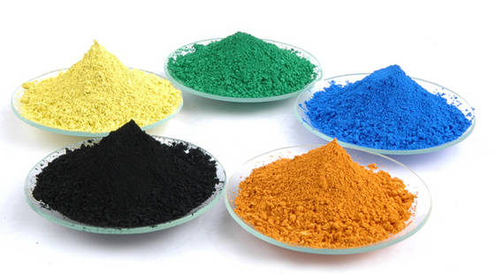
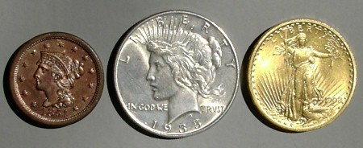
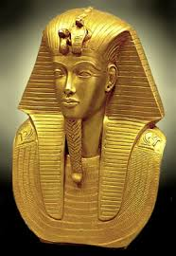
Why do we care about transition metals?
Construction
Pigments
Essential for life
Coins
Catalysis
Jewelery and culture
Pollution

Slide 3
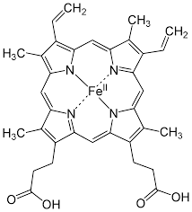
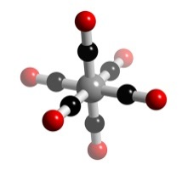
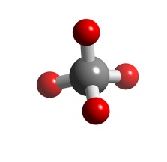
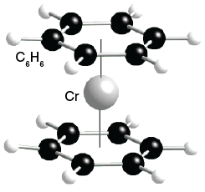
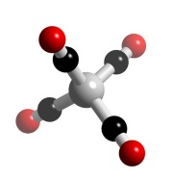
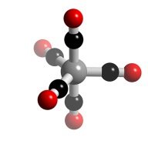
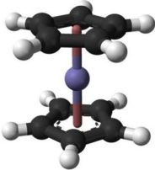
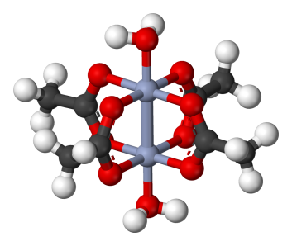
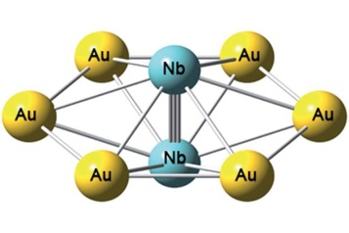
Most of all: Really interesting chemistry!
Multiple oxidation states make TMs important for redox chemistry:
Examples: Mn(II), Mn(III) (rare), Mn(IV), Mn(VI), Mn(VII), as in
MnCl₂ Mn₂O₃ MnO₂ MnO₄²⁻ MnO₄⁻
manganese(II) manganese(III) manganese manganate permanganate
chloride oxide dioxide ion ion
d-orbital shapes allow chemical bonding in unusual ways:
High-order multiple bonds are possible:
Ni(CO)₄
Fe(CO)₅
Cr(CO)₆
OsO₄
Fe(C₅H₅)₂ ,
ferrocene
Cr(C₆H₆)₂ ,
bisbenzenechromium
Heme
Nb₂Au₆
A Nb≡Nb triple bond
(only known in gas phase)
W₂
A W≡W sextuple bond
(only known in gas phase)
Cr₂(CH₃CO₂)₄∙2H₂O
A Cr-Cr quadruple bond
[Re₂Cl₈]^{2‒}
A Re-Re quadruple bond

Slide 4
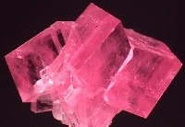
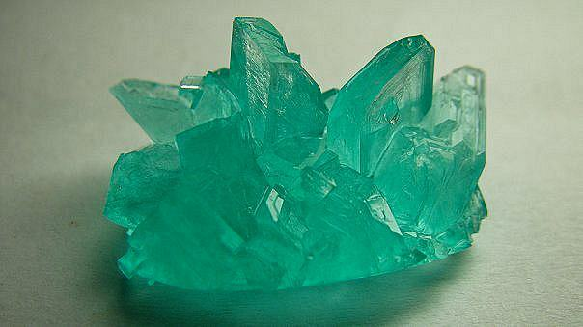
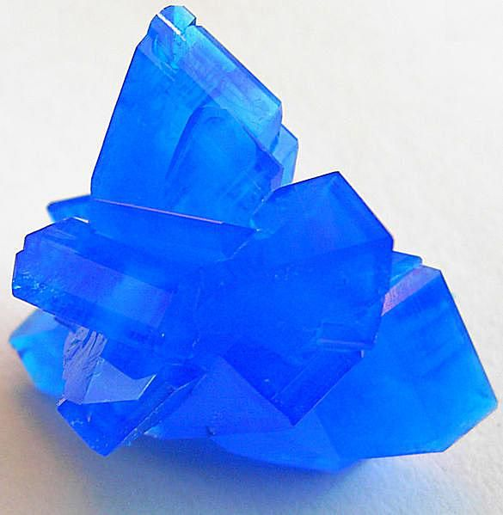
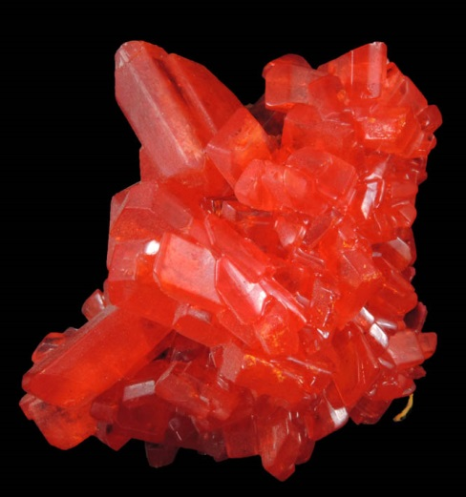
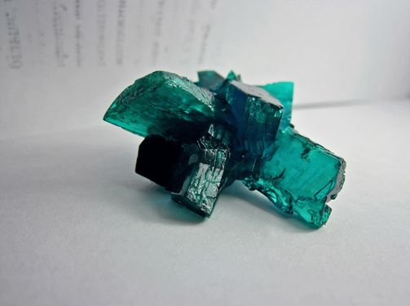
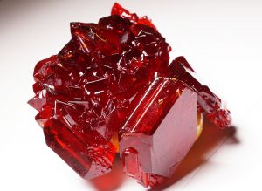
And really beautiful colors!
MnCO₃
FeSO₄∙7H₂O
CuSO₄∙5H₂O
K₂Cr₂O₇
Ni(NO₃)₂∙6H₂O
K₃Fe(CN)₆

Slide 5
Ground Electronic Configurations of the Atoms
Group 3 | Group 4 | Group 5 | Group 6 | Group 7 | Group 8 | Group 9 | Group 10 | Group 11 | Group 12
Sc 3d¹4s² | Ti 3d²4s² | V 3d³4s² | Cr 3d⁵4s¹ | Mn 3d⁵4s² | Fe 3d⁶4s² | Co 3d⁷4s² | Ni 3d⁸4s² or 3d⁹4s¹ | Cu 3d¹⁰4s¹ | Zn 3d¹⁰4s²
Y 4d¹5s² | Zr 4d²5s² | Nb 4d⁴5s¹ | Mo 4d⁵5s¹ | Tc 4d⁵5s² | Ru 4d⁷5s¹ | Rh 4d⁸5s¹ | Pd 4d¹⁰5s⁰ | Ag 4d¹⁰5s¹ | Cd 4d¹⁰5s²
Lu 5d¹6s² | Hf 5d²6s² | Ta 5d³6s² | W 5d⁴6s² | Re 5d⁵6s² | Os 5d⁶6s² | Ir 5d⁷6s² | Pt 5d⁹6s¹ | Au 5d¹⁰6s¹ | Hg 5d¹⁰6s²
Why do most atoms have s² configurations, some (Cr, Cu, Nb, Mo, Ru, Rh, Ag, Pt, and Au) have s¹ configurations, and only Pd has an s⁰ configuration?

Slide 6
Exchange Stabilization
You know that when filling in the electrons to construct an orbital diagram, we teach students to fill in the spins all spin up, then add more electrons spin down. This leads to orbital diagrams like:
↑
↑
↑
But why does this happen? It’s because when you work out the energy of the state, there’s a term that’s subtracted from the total energy (called the exchange energy) for every pair of electrons with the same spin. The same term is added to the energy for every pair of electrons with opposite spin. So states with the electrons all aligned in the same direction are favored, compared to ones that have them spin paired – assuming the orbitals aren’t too far apart in energy.
In something like Cr, the 3d⁵ 4s¹ configuration is favored, because it has 6 electrons with their spins aligned. This means 15 different pairs of electrons (6×5/2), all contributing a term that lowers the energy. This is more than enough to stabilize this configuration compared to 3d⁴ 4s², which only has 5 electrons (5×4/2 = 10 different pairs) with the same spin (and 5 pairs with opposite spins, which is unfavorable). Of course, this is only possible because the 3d and 4s orbitals aren’t too far apart in energy. This explains why Cr and Mo have d⁵ s¹ configurations.
What about Cu, Ag, and Au?
↑↓
↑↓
N 1s² 2s² 2p³

Slide 7
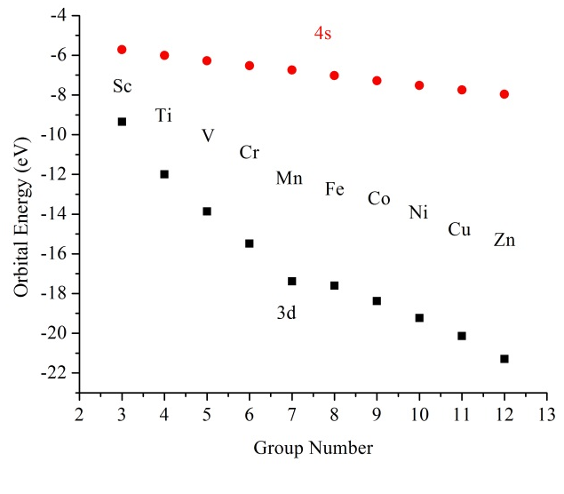
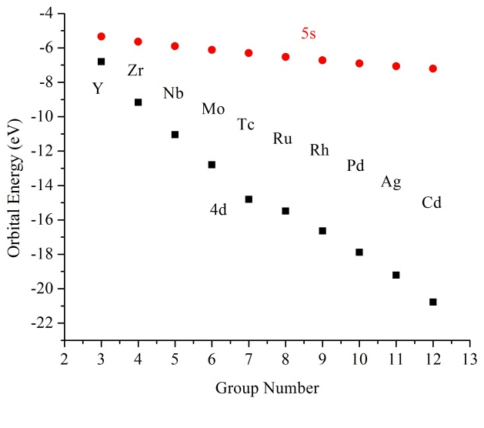
Orbitals Drop in Energy Going to the Right in the Periodic Table
As you move to the right, with each step you add one nuclear charge and one electron. The added nuclear charge pulls the electrons in more tightly, which has two effects: (1) It causes the electrons to be bound more tightly, so the energies of the d- and s-orbitals drop, and (2) because the orbital energies are lower, the orbitals are smaller in size (this is a consequence of being more tightly bound).
Because the s-orbital is larger than the d-orbitals, it is better shielded from the added nuclear charge than the d-orbitals are, and its energy doesn’t drop so fast:
By the time you get to Cu, Ag, and Au, the d-orbitals are so low in energy that the d¹⁰s¹ configuration is most favorable. This effect also favors d-orbital occupation in the 4d series much more than in the 3d series, leading to all the anomalies in this series.

Slide 8
Special Relativity and Atomic Orbitals
Although the Schrödinger equation explains the light atoms very well, it is not the final story, because it is not relativistically correct. To properly treat atoms with large nuclear charge, you need to use the Dirac equation.
In a nutshell, here’s how special relativity affects chemistry:
1. Relativity only becomes important when objects move at speeds close to the speed of light (the cosmic speed limit)
2. Einstein says that as an object approaches the speed of light, its mass increases: $m=\frac{m_{0}}{\sqrt{1−\frac{v^{2}}{c^{2}}}}$ .
3. When does an electron move fast? When it gets close to the nucleus, especially if the nucleus has a large nuclear charge (i.e., a heavy element)! This is also much more important for s-electrons, which can get all the way to the nucleus. Due to their angular momentum, p-electrons don’t spend much time very close to the nucleus; d- and f-electrons, even less so.
4. Remember the formula for the Bohr radius: ${a }_{0}=\frac{4πε_{0}ℏ^{2}}{m_{e}e^{2}}$. Because the mass of the electron changes in relativistic theory as it moves faster, the presence of the electron mass in the denominator means that for electrons that move fast, the atomic scale of length (the Bohr radius) shrinks – those orbitals undergo a relativistic contraction. These are the orbitals that penetrate close to the nucleus – the s-orbitals. Further, when the s-orbitals contract, they shield the d- and f-electrons more effectively, and these orbitals expand. This really matters in the 5d series and in heavier elements.

Slide 9
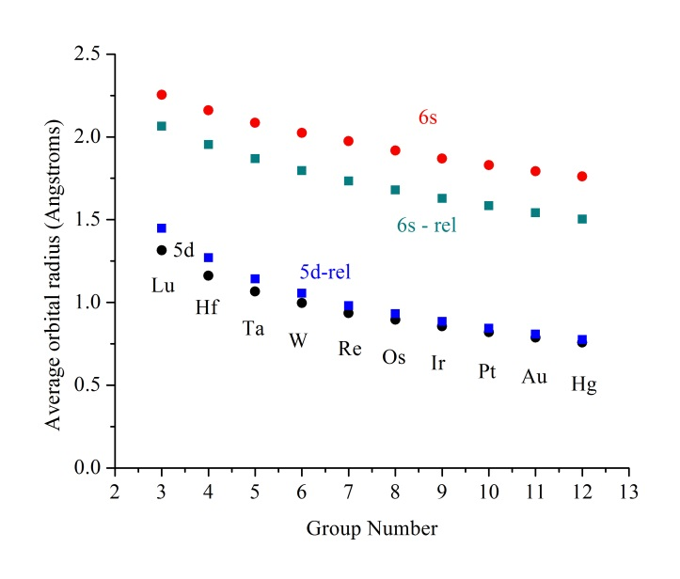
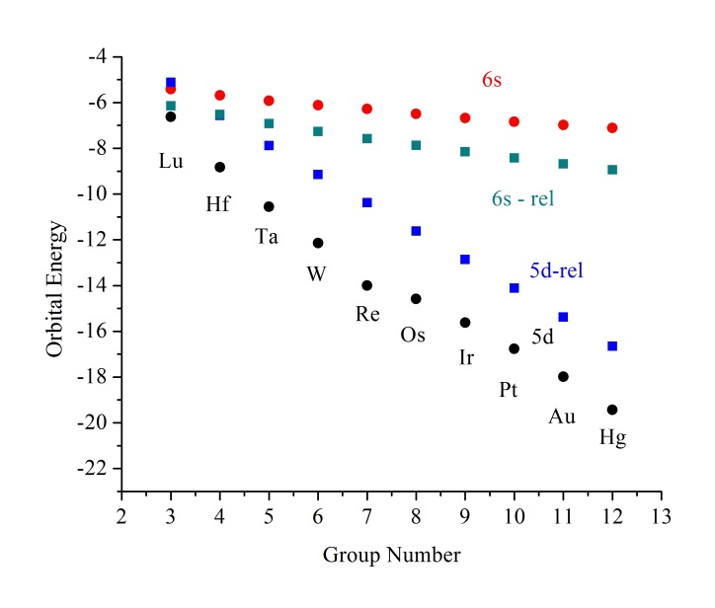
Relativistic Effects on the 5d and 6s Orbitals
Relativity lowers the energy of the 6s orbital and raises the energy of the 5d orbitals substantially. This makes the 5d orbitals much more available for bonding in the 5d series than the 4d or especially the 3d series. Likewise, the 6s orbital drops in size due to relativity. These facts explain many difficult facts about the transition metals:
Why is the ground state of W 5d⁴ 6s²? (Relativity stabilizes the 6s orbital)
Why are the only metals with melting points above 3000 K (Ta, W, Re, Os) in the 5d-series? (Because the 5d-orbitals aren’t “hidden” under the 6s so much as in the other transition metal series, so they’re make stronger bonds).
Why does Au₂ have a shorter bond length than Ag₂ (2.472 Å vs. 2.534 Å)? (Relativistic contraction of the 6s orbital is large, because of the high nuclear charge in gold.)
Why don’t Ir, Pt, Au tarnish? (Relativity lowers the 6s orbitals, increasing the ionization energy, making these metals difficult to oxidize.)

Slide 10
More Strange Facts Explained by Relativistic Effects
Why can gold form a stable anion, Au‒ ? (Relativity stabilizes the 6s orbital, so that
it can take an extra electron.) This forms the auride ion, Au‒ 5d¹⁰ 6s², which has
been crystallized as Cs⁺Au‒ and [N(CH₃)₄]⁺ Au‒.
Why does the mercury(I) ion take the form Hg₂²⁺ ? How can this ion be so stable that it can accommodate two +1 charges in a diatomic molecule? (The small size of the 6s orbital, which occurs due to relativity, allows for a stronger bond than could otherwise be formed.)
Why does aluminum only occur in the Al³⁺ oxidation state, but thallium is stable as Tl⁺? (The 6s orbitals are lowered so much, due to relativity, that it is possible to oxidize thallium in steps, first to +1, then to +3. In aluminum, the 3s and 3p orbitals are too close in energy to do this.) [This is called the inert pair effect, where the 6s electrons are relatively more inert than the 6p electrons.]
Why is silver silvery-colored (more or less like most metals), but gold is colored? (In silver, the 4d orbitals have dropped very low in energy, so that the 4d → 5s excitation is quite high in energy, about 3.7 eV. In gold, the relativistic stabilization of the 6s orbital reduces the energy gap to about 1.7 eV, which places the excitation in the visible. This gives gold its golden color.)

Slide 11
Melting Points of the Transition Metals (K)
Sc 1812 | Ti 1943 | V 2175 | Cr 2130 | Mn 1517 | Fe 1809 | Co 1768 | Ni 1726 | Cu 1356 | Zn 693
Y 1799 | Zr 2125 | Nb 2740 | Mo 2896 | Tc 2473 | Ru 2523 | Rh 2233 | Pd 1825 | Ag 1235 | Cd 594
Lu 1929 | Hf 2500 | Ta 3287 | W 3680 | Re 3453 | Os 3300 | Ir 2716 | Pt 2042 | Au 1337 | Hg 234
d-electrons fill bonding orbitals in the crystalline solid; bonding strengthens (generally) as you go to the right.
d-electrons fill antibonding orbitals in the crystalline solid; bonding weakens (generally) as you go to the right.
The zinc column has very low melting points, because these are closed shell atoms (d¹⁰ s²). By rights, they should be nearly inert gases, like He (1s²) and the other rare gases. They only form solids because the np band overlaps with the ns band. Essentially, some of the highest antibonding electrons in the ns band lower their energy by moving to the most strongly bonding orbitals in the np band. This is enough to make these elements solids at room temperature. Because the 6s orbital is stabilized so strongly by relativity, there is a big gap between the 6s and 6p in Hg, and Hg is almost a gas at room temperature. The next element down, copernicium, is even more volatile than Hg – it is thought to be a gas.

Slide 12
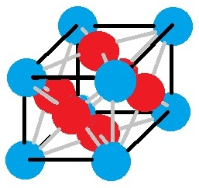
Alloys
An alloy is a mixture of atoms that consist mainly of metals, and which behaves as a metal (electrically conductive, shiny, conducts heat, etc.). There are different types:
Solid solutions – here, the atoms of one element can replace those of the other element across a range of compositions, just as two liquids can be soluble in each other. There’s no fixed mole ratio. A good example is brass:
Here, Cu and Zn atoms are able to interchangeably occupy positions in a crystal lattice. Below a certain temperature, the positions become ordered, but above that temperature the atoms become randomly arranged.
Another type of alloy is an intermetallic compound, in which the atoms combine in definite proportions and occupy specific positions in a crystal lattice. Because the atoms occupy specific positions, these materials are often brittle and not ductile or malleable. An example is Nb₃Sn, which becomes superconductive at low temperatures.
Sn atoms (gray)
Nb atoms (light blue)

Slide 13
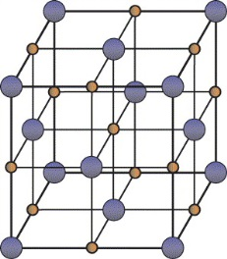
Alloys (continued)
Interstitial alloys – here, a light element (such as H, B, C, or N)fit in between the atoms of the heavier metal. One example is the dissolution of H₂ into metallic palladium, where H atoms fit into the spaces between the palladium atoms. The Pd crystal is a face centered cubic crystal. When H₂ dissolves in Pd, the H atoms randomly occupy the octahedral holes between Pd atoms. In the process, the crystal lattice expands significantly. Pd can absorb up to 900 times its volume in H₂ gas.
Pd atoms
(gray)
Palladium hydride with all hydrogen sites (small orange spheres) occupied. In reality, the highest hydrogen content that has been achieved is PdH_{0.58}.
H atom
sites
(orange)
Iron is a soft metal, in which the Fe atoms can slip past each other readily. Small amounts of carbon are kept in the molten iron to make carbon steel, however. These go into the interstitial positions and keep the iron atoms from moving past each other so readily, greatly increasing the hardness of the material.
Stainless steel is both a substitutional alloy (with some Ni replacing Fe) and an interstitial alloy (with interstitial carbon hardening the material).

Slide 14
But what about transition metal compounds?

Slide 15
The 18 electron rule
Most transition metals form compounds that obey the 18-electron rule. The idea is that the metal interacts with ligands to bring the total electron count associated with the metal to 18 electrons. This brings the metal to a rare gas configuration.
For example, Fe has 8 valence electrons (4s²3d⁶). If it is complexed with :C≡O:, each CO can donate 2 lone pair electrons to Fe. To bring the total electron count to 18 (bringing the Fe atom to a Kr configuration), 10 more electrons (or 5 CO molecules) will be required. Hence, we have the compound Fe(CO)₅.
Ni (4s²3d⁸) has 10 electrons, so only 4 CO ligands (each donating 2 electrons) are required. Hence, Ni(CO)₄.
In solution, metal ions form complexes, like [Fe(H₂O)₆]²⁺. Fe²⁺ has 6 valence electrons (8-2), and each H₂O donates 2 electrons, giving 6 + 6×2 = 18 e‒.
Many other complexes (but not all!) satisfy the 18-electron rule:
[Ag(NH₃)₄]⁺ ; [PtCl₆]^{2‒} ; Cr(C₆H₆)₂ ; Fe(C₅H₅)₂ ; Co(CO)₃NO
Here, :NH₃, Cl‒, and CO each donate two electrons, functioning as a Lewis base donating a pair of electrons in a σ-fashion. Each of the 6 π-electrons in benzene, or the 5 π-electrons in C₅H₅ is shared with the metal, to give 18 electrons in Cr(C₆H₆)₂ or Fe(C₅H₅)₂. In Co(CO)₃NO, the NO binds via 3 electrons, one from its unpaired electron and two from its π-system. In some other cases, NO only binds through a single electron.

Slide 16
Other examples (good electron counting problems for your students):
[Mn(CO)₅C₂H₄]⁺
(the ethylene shares 2 electrons from its π–bond with the metal)
HCo(CO)₄ or its anion, [Co(CO)₄]‒
Ni(C₅H₅)NO - does the NO bind through 1 electron, or 3 electrons?
This matters, structurally. When it binds through 1 electron, the M-N-O bond is bent, as in CH₃NO; when it binds through 3 electrons, it is linear.
Mn(C₃H₅)(CO)₄ - the allyl radical, C₃H₅ , is similar to NO. It can bond through one electron (a monohapto complex) or through three electrons (a trihapto complex). Which is this?

Slide 17
Other examples (good electron counting problems for your students):
[Mn(CO)₅C₂H₄]⁺
(the ethylene shares 2 electrons from its π–bond with the metal)
HCo(CO)₄ or its anion, [Co(CO)₄]‒
Ni(C₅H₅)NO - does the NO bind through 1 electron, or 3 electrons?
This matters, structurally. When it binds through 1 electron, the M-N-O bond is bent, as in CH₃NO; when it binds through 3 electrons, it is linear.
Mn(C₃H₅)(CO)₄ - the allyl radical, C₃H₅ , is similar to NO. It can bond through one electron (a monohapto complex) or through three electrons (a trihapto complex). Which is this?
Mn is in group 7, so it starts with 7 e‒. Each CO donates 2 e‒, making 17. Ethylene donates another 2 e‒, making 19. Finally, the molecule carries a + charge, bringing the total to 18.
Co is in group 9, so we start with 9 e‒. Each CO donates 2 e‒, making 17. Making the anion adds one e‒, making 18. Adding an H⁺ makes the HCo(CO)4 acid, but doesn’t change the electron count.
Ni is in group 10, so we start with 10. C₅H₅ donates 5 electrons, giving 15. To get to 18, the NO has to bind with 3 electrons, which it does with its one radical electron and with a π-electron pair.
Mn starts with 7 electrons, we add 8 from the 4 CO ligands to get 15, so the C₃H₅ allyl radical must bond through three electrons. This radical is planar, and its three carbons bond to the Mn atom through the three π-orbitals, each bonding with one electron. The C₃H₅ radical bonds to the Mn atom by presenting one face of the planar system to the Mn.

Slide 18
The transition metals are all about the behavior of the d-electrons
If you consider the set of all quadratic functions in x, y, and z, you have six functions:
{x², y², z², xy, xz, and yz}. The d-orbitals are formed by the product of a quadratic function times a spherically symmetric function, to form something with two angular nodes (usually nodal planes). So why aren’t there 6 d-orbitals?
It’s because one combination of this set is spherically symmetric: x²+y²+z².
When this function is removed, you get five linearly independent functions:
{x², y², z², xy, xz, and yz} $⇒$ {x²+y²+z²} $⊕${x² - y², 2z² - x² - y², xy, xz, and yz}
A spherically symmetric
function – has the symmetry
of an s-orbital
Five linearly independent quadratic functions – the d-orbitals (when multiplied by the appropriate spherically symmetric function).
Note: there’s nothing special about the z-axis. There are other sets of d-functions that don’t look like this. For example, if we wanted we could choose other sets, like these:
The dy² set: {x² - z², 2y² - x² - z², xy, xz, and yz}
The dx² set: {y² - z², 2x² - y² - z², xy, xz, and yz}
Typically, in a molecule we choose the z-axis along the axis of highest symmetry.

Slide 19
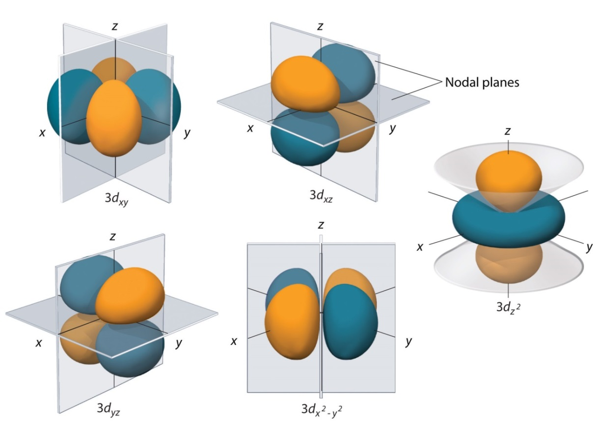
The d-orbitals: What do they look like?
These functions are a quadratic form {xy, xz, yz, x² - y², or 2z² - x² - y²,} times a spherically symmetric function. The quadratic form determines the location of the angular nodes, which are planes or in the case of the dz² orbital, cones.
The d_{xy} orbital, for example, is xy times a spherically symmetric function, so it is zero when x=0 or y=0. These are the planes that contain the y and z axes (the yz plane, where x=0) and the x and z axes (the xz plane, where y=0).

Slide 20
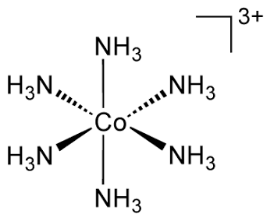
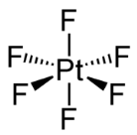
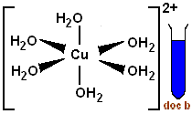
What happens to the d-orbitals when ligands approach?
Many transition metal ions, in solution or in crystalline compounds, are surrounded by 6 ligands in an octahedral geometry. Examples include the complex ions:
[Co(NH₃)₆]³⁺ [PtF6]2‒
hexamminecobalt(III) hexafluoroplatinate(IV)
[Cu(H₂O)₆]²⁺ Cr(CO)₆
hexaaquacopper(II) chromium hexacarbonyl
2‒

Slide 21
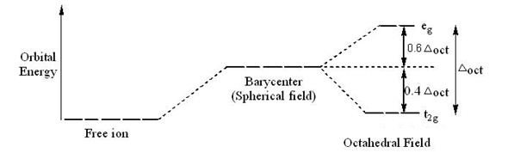
Crystal Field Theory (developed in 1929 – 1935) by Hans Bethe and John Hasbrouck Van Vleck
Basic Idea: Treat ligands as point charges, and calculate the effect on the d-orbital energies.
Result: The d-orbitals split in energy, depending on how directly they point toward the negatively charged ligands.
The splitting between the three t_{2g} orbitals and the two e_{g} orbitals is also called 10Dq. This is exactly the same quantity as Δ.
The three t_{2g} orbitals (d_{xy}, d_{xz}, d_{yz}) point directly between the ligands, so they don’t feel a repulsion from the negative charge so strongly. The two e_{g} orbitals (d_{x}2_{-y}2, d_{z}2) point directly toward the ligands (which are located on the x, y, and z axes) and are pushed up in energy:

Slide 22
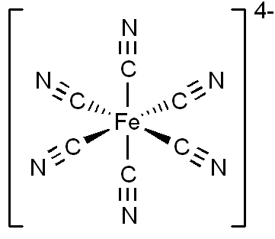
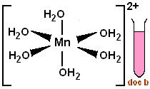
Ligand Field Theory: Crystal Field Theory Generalized to Include Molecular Orbitals
Now the 10Dq (or Δ) splitting depends on the nature of the ligands and on the transition metal atom.
TM atoms with larger d-orbitals or that are more highly charged give stronger interactions → larger 10Dq splitting: Co³⁺ < Rh³⁺ <Ir³⁺ ; Fe²⁺ < Fe³⁺
Likewise, ligands that interact more strongly lead to a greater 10Dq splitting:
I⁻ < Br⁻ < Cl⁻ < F⁻ < H₂O < NH₃ < CN⁻
Weak field ligands tend to form high-spin complexes; strong-field ligands form low-spin complexes: Mn²⁺ has 5 3d electrons.
Mn
Hexaquomanganate(II) - a high-spin complex
Hexacyanomanganate(II) - a low-spin complex
Interesting and perhaps useful magnetic behavior!

Slide 23
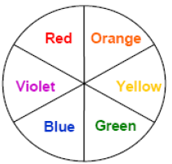
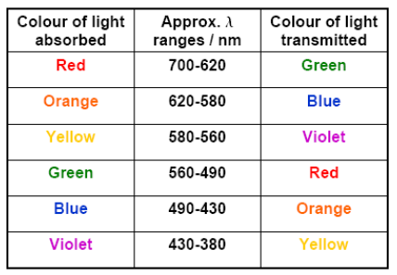
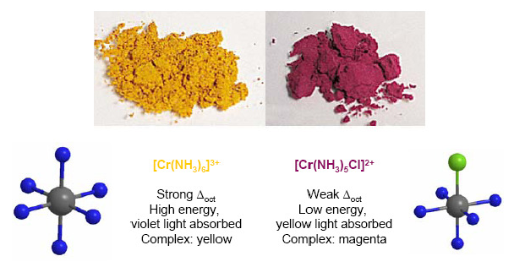
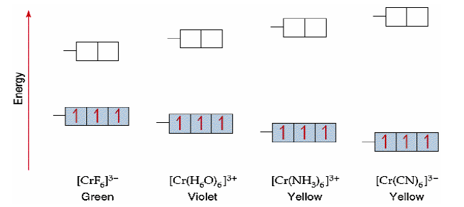
How the Color of a Transition Metal Complex Depends on the Ligand Field Splitting
The 10Dq (or Δ) splitting determines the wavelength that will be absorbed, which determines the color of the complex. The color of the transition metal octahedral complex varies depending on the ligands:
To find the color of the complex, look across the color wheel from the color of light that is absorbed. If violet light is absorbed, the compound is yellow, etc.

Slide 24
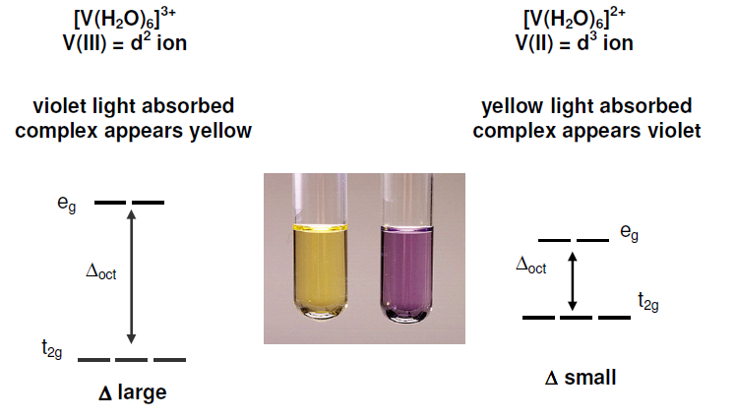
How the Color of a Transition Metal Complex Depends on the Ligand Field Splitting: Another Example
Remember, a more highly charged metal ion interacts more strongly with the ligands, leading to a larger value of Δ or 10Dq.

Slide 25
Thanks for listening!
Anytime you’d like to ask me a question:
morse@chem.utah.edu
This and all previous presentations can be found at my website:
https://chem.utah.edu/directory/morse/research-group/ap_chemistry_powerpoints.php

