Slide 1
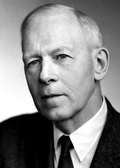
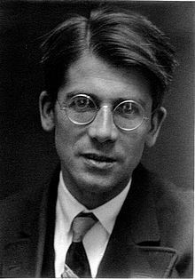
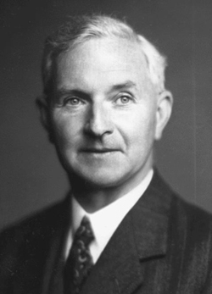
Molecular Orbital Theory presented by: Michael Morse, University of Utah morse@chem.utah.edu
Main Developers of MO Theory:
Robert S. Mulliken Friedrich H. Hund John Lennard-Jones
American (1896-1986) German (1896-1997) British (1894-1954)
Nobel Prize, 1966 No Nobel Prize No Nobel Prize

Slide 2
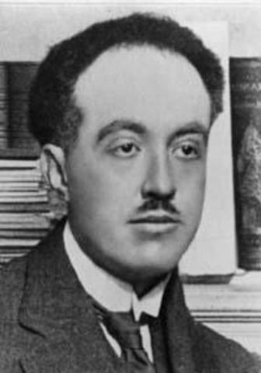
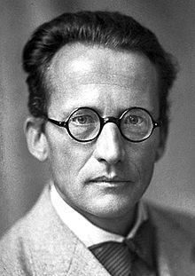
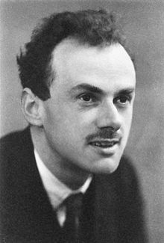
First, a brief look at Quantum Mechanics
Particles behave like waves (Louis de Broglie, 1924; Nobel Prize, 1929)
A particle moving with a momentum p = mv has an associated wave
with wavelength λ, given by λ = h/p = h/(mv)
(h is Planck’s constant, 6.626 × 10⁻³⁴ Joule – seconds)
De Broglie’s wave follows a wave equation
(Erwin Schrödinger, 1926; Nobel Prize, 1933)
$\hat{H}ψ=Eψ$ or $−\frac{h^{2}}{8π^{2}m}\frac{d^{2}ψ}{{dx}^{2}}+Vψ=Eψ$ for a particle of mass m moving
in the x-dimension, subject to a potential energy function V(x).
This gets more complicated for particles moving in more than one
dimension, or more than one particle. ${ψ(x)}^{2} dx$ gives the probability of
finding the particle between x and x + dx.
Paul Dirac generalized Schödinger’s Equation to obey Einstein’s Theory of
Special Relativity (1928; Nobel Prize, 1933)
“The underlying physical laws necessary for the mathematical theory of
a large part of physics and the whole of chemistry are thus completely
known, and the difficulty is only that the exact application of these laws
leads to equations much too complicated to be soluble.” (1929)

Slide 3
If the equations are too complicated to be soluble, what can we do?

Slide 4
If the equations are too complicated to be soluble, what can we do?
Make approximations!

Slide 5
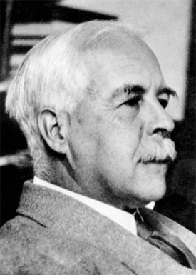
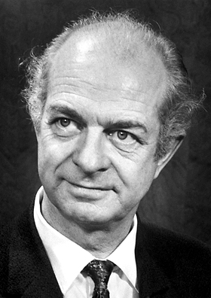
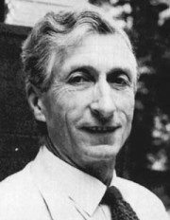
Valence Bond Theory [A very atom-based approximation scheme]
Remember Lewis dot structures? (G. N. Lewis, 1916. Sadly – no Nobel Prize, despite being nominated 41 times!)
H∙ + H∙ → H:H (a shared electron pair forms a bond)
Linus Pauling and Charles Coulson took this idea and formulated it as Valence Bond Theory, where each atom keeps its electron, but the spins are paired:
$$ψ\left(1, 2\right)=\left[1s_{A}\left(1\right)1s_{B}\left(2\right)+1s_{B}\left(1\right)1s_{A}\left(2\right)\right] ×[spin−paired wavefunction]$$
Electron #1 is on nucleus A while electron #2 is on nucleus B
Electron #1 is on nucleus B while electron #2 is on nucleus A
Linus Pauling
Nobel Prize 1954
Charles Coulson
no Nobel Prize

Slide 6
A Different Approximation Scheme: Molecular Orbital Theory [A very molecule-based approximation scheme]
Instead of keeping the electrons in atomic orbitals, we can place them in molecular orbitals that extend over the entire molecule. This is based on the idea that the electrons are attracted to all the nuclei in the molecule, so we can expect them to extend over the entire molecule.
Note: Either approach is an approximation! But the molecular orbital approach is easier to implement in quantum chemical calculations. It also explains excited states of molecules in a more straightforward way.
For H₂, this approach uses an approximate wavefunction in which each electron is placed in a molecular orbital that extends over the entire molecule:
$$ψ\left(1, 2\right)=\left[1σ_{g}\left(1\right)1σ_{g}\left(2\right)\right] ×[spin−paired wavefunction]$$
The $1σ_{g}$ orbital is the simplest of the molecular orbitals. It is a wavefunction that extends over both hydrogen nuclei. Just like atomic orbitals, it can hold two electrons, which must have opposite spins.

Slide 7
Linear Combination of Atomic Orbitals – Molecular Orbital Method LCAO-MO
How can we come up with molecular orbitals? These are functions that depend on the (x, y, z)-coordinates of the electrons, and have a particular value at every point in space. One of the simplest methods is to take them as linear combinations of atomic orbitals. In this approach, the simplest possible LCAO for the $1σ_{g}$orbital of H₂ is:
$$1σ_{g}=C ( 1s_{A}+ 1s_{B})$$
1s orbital centered on nucleus A
1s orbital centered on nucleus B
With this combination, an electron in the 1$σ_{g}$ orbital is equally likely to be found in the 1s orbital on atom A as on atom B.
In linear molecules, a $σ$ orbital is cylindrically symmetric about the axis of the molecule. Looking down the molecular axis, it looks circular.
Looking down the axis:
$1σ_{g}orbital$:
This is a bonding orbital, because the atomic orbitals add up in phase between the two atoms, leading to an increase in electron density just where it is needed to hold them together.

Slide 8
Valence Bond vs. Molecular Orbital Theory
In the simplest form of MO theory, we use a wavefunction:
$ψ\left(1,2\right)=1σ_{g}\left(1\right)1σ_{g}\left(2\right)×\left[spin−paired wavefunction\right]$
$=\left[1s_{A}\left(1\right)+1s_{B}\left(1\right)\right]\left[1s_{A}\left(2\right)+1s_{B}\left(2\right)\right]×\left[spin−paired wavefunction\right]$
Multiplying this out:
$=\left[1s_{A}\left(1\right)1s_{A}\left(2\right)+1s_{B}\left(1\right)1s_{A}\left(2\right)+1s_{A}\left(1\right)1s_{B}\left(2\right)+1s_{B}\left(1\right)1s_{B}\left(2\right)\right]×\left[spin−paired wavefunction\right]$
Rearranging:
$=\left[1s_{A}\left(1\right)1s_{B}\left(2\right)+1s_{B}\left(1\right)1s_{A}\left(2\right)+1s_{A}\left(1\right)1s_{A}\left(2\right)+1s_{B}\left(1\right)1s_{B}\left(2\right)\right]$ $×\left[spin−paired wavefunction\right]$
One electron on each atom – a “covalent structure”
One electron on each atom – a “covalent structure”
Both electrons are on atom A – an “ionic structure”
(H‒ H⁺)
Both electrons are on atom B – another “ionic structure”
(H⁺ H‒)
MO Theory has equal contributions from “covalent” and “ionic” structures
In the simplest form of VB theory, we use a wavefunction:
$ψ\left(1,2\right)=\left[1s_{A}\left(1\right)1s_{B}\left(2\right)+1s_{B}\left(1\right)1s_{A}\left(2\right)\right]$ $×\left[spin−paired wavefunction\right]$
This keeps one electron on each atom – it only has contributions from “covalent structures”

Slide 9
Valence Bond vs. Molecular Orbital Theory
Which approximation is better?
The best approximation is somewhere in between,
(both covalent and ionic structures, but mainly covalent)
$ψ\left(1,2\right)=\left\{\begin{aligned}0.968[1s_{A}\left(1\right)1s_{B}\left(2\right)+1s_{B}\left(1\right)1s_{A}\left(2\right)] \\ +0.252[1s_{A}\left(1\right)1s_{A}\left(2\right)+1s_{B}\left(1\right)1s_{B}\left(2\right)\end{aligned}\right\}$ $×\left[spin−paired wavefunction\right]$
Note: the coefficient in front tells the relative importance of that structure
(really c² does)
In this case, c² for the covalent structures is (0.968)² = 0.937
c² for the ionic structures is (0.252)² = 0.063
H₂ is 93.7% covalent, 6.3% ionic in character (although both H‒ H⁺ and H⁺ H‒ make equal contributions, so there’s no net dipole moment). Close enough to call it a covalent molecule. But you all knew that already!

Slide 10
What about molecules with more electrons?
Use the LCAO method to construct higher energy molecular orbitals!
For He₂, we have four electrons altogether. Since the 1$σ_{g}$ orbital can only hold 2 electrons, we need another orbital. It turns out there is another way to combine the two 1s orbitals (1s_{A} and 1s_{B}), which is taking the difference:
$${1σ}_{u}=1s_{A}−1s_{B}$$
Looking down the axis: Still a $σ$orbital
Pictorially, the ${1σ}_{u}$ orbital looks like this:
(Here different colors correspond to the different signs of the wavefunction; one color is positive, the other negative)
1s_{B} has a negative sign.
The wavefunction has a
negative value here
1s_{A} has a positive sign.
The wavefunction has a
positive value here
Where the wavefunction changes sign is called a node – in this case, it is a planar nodal surface. This depletes electron density between the two nuclei, causing nuclear-repulsion to increase. This makes this an antibonding orbital.

Slide 11
Molecular orbital diagram for H₂
Orbital Energy
1σ_{u} – antibonding
(empty in H₂)
↑
↑
1s_{A}
1s_{B}
↑↓
1σ_{g} - bonding
H atom A
H atom B
The Bond Order (B.O.) is defined as
B.O.=[(# of electrons in bonding orbitals) – (# of electrons in antibonding orbitals)]/2
B.O. = [2-0]/2 = 1 for H₂. H₂ has a single bond.

Slide 12
Molecular orbital diagram for He₂
Orbital Energy
↑↓
Note: The antibonding orbital goes up in energy more than the bonding orbital goes down! As a result, there is no net bonding in He₂, and helium exists as a monatomic gas.
1σ_{u} - antibonding
↑↓
↑↓
1s_{A}
1s_{B}
↑↓
1σ_{g} - bonding
He atom A
He atom B
B.O. = [2-2]/2 = 0 for He₂. He₂ is no bond; it is unbound.

Slide 13
A brief note: What does g/u mean?
These crazy subscripts tell whether the wavefunction stays the same when the electron is moved through the center to the opposite side, changing (x, y, z) to (-x, -y, -z), or if it changes sign.
If it stays the same, it is “g”, or “gerade” (from the German word for “even”)
If it changes sign, it is “u”, or “ungerade” (from the German word for “odd”)
${1σ}_{g}$ orbital – stays the same
${1σ}_{u}$ orbital – changes sign

Slide 14
Molecular orbital diagram for Li₂
Orbital Energy
2σ_{u} - antibonding
Valence orbitals-
Responsible for chemical bonds.
2s_{A}
↑
↓
2s_{B}
↑↓
2σ_{g} - bonding
Core orbitals-
No overlap, too close to the nucleus; no contribution to bonding. Much lower in energy than shown!
↑↓
↑↓
1σ_{u} - core
↑↓
1s_{A}
↑↓
1s_{B}
Li atom A
1σ_{g} - core
Li atom B
B.O. = [2-0]/2 = 1 for Li₂. Li₂ has a single bond
(MUCH weaker than H₂, though).

Slide 15
Molecular orbital diagram for Be₂
Orbital Energy
↑↓
2σ_{u} - antibonding
Valence orbitals-
Responsible for chemical bonds.
↑↓
↑↓
2s_{A}
2s_{B}
↑↓
2σ_{g} - bonding
Core orbitals-
No overlap, too close to the nucleus; no contribution to bonding. Much lower in energy than shown!
↑↓
↑↓
1σ_{u} - core
↑↓
1s_{A}
↑↓
1s_{B}
Be atom A
1σ_{g} - core
Be atom B
B.O. = [2-2]/2 = 0 for Be₂. Be₂ has a bond order of 0 and should be unbound. This is oversimplified, and it is very weakly bound.

Slide 16
When p orbitals get involved, the shapes get more interesting!
With p orbitals, you can get two different types of bonds:
bonds and π bonds.
σ orbitals have cylindrical symmetry about the molecular axis,
no nodal planes containing the axis
π orbitals have one nodal plane containing the axis
Looking down the axis:
Cylindrical Symmetry, no nodal planes: σ orbital
One nodal plane:
π orbital
σ interaction of 2p orbitals:
π interaction of 2p orbitals:
z
z
Atom Atom
A B
Atom Atom
A B
In each orientation, the orbitals can approach so they overlap constructively to
form bonding orbitals, or destructively to form antibonding orbitals.
z
z
z
z
-2p_{zA} + 2p_{zB} 2p_{zA} + 2p_{zB}
3σ_{g} 3σ_{u}*
2p_{xA} + 2p_{xB} -2p_{xA} + 2p_{xB}
1π_{u} 1π_{g}*
Bonding Antibonding Bonding Antibonding

Slide 17
Molecular orbital diagram for B₂
3σ_{u} - antibonding
Orbital Energy
1π_{g} - antibonding
↑
↑
2p_{A}
2p_{B}
↑
↑
3σ_{g} - bonding
Valence orbitals-
Responsible for chemical bonds.
1π_{u} - bonding
↑↓
2σ_{u} - antibonding
↑↓
↑↓
2s_{A}
2s_{B}
↑↓
2σ_{g} - bonding
≈
1σ_{u} - core
1s_{A}
↑↓
↑↓
↑↓
↑↓
1s_{B}
Core orbitals
B atom A
1σ_{g} - core
B atom B
B.O. = [4-2]/2 = 1 for B₂. B₂ has a bond order of 1.

Slide 18
Ground state electronic configurations of diatomic molecules
Bond energy
H₂ 1σ_{g}² BO = 1 4.478 eV
He₂ 1σ_{g}² 1σ_{u}² BO = 0 0.00000008 eV
Li₂ [1σ_{g}² 1σ_{u}²] 2σ_{g}² BO = 1 1.05 eV
Be₂ [1σ_{g}² 1σ_{u}²] 2σ_{g}² 2σ_{u}² BO = 0 0.1 eV
B₂ [1σ_{g}² 1σ_{u}²] 2σ_{g}² 2σ_{u}² 1π_{u}² BO = 1 3.05 eV
C₂ [1σ_{g}² 1σ_{u}²] 2σ_{g}² 2σ_{u}² 1π_{u}⁴ BO = 2 6.25 eV
N₂ [1σ_{g}² 1σ_{u}²] 2σ_{g}² 2σ_{u}² 1π_{u}⁴ 3σ_{g}² BO = 3 9.71 eV (Strong bond!)
O₂ [1σ_{g}² 1σ_{u}²] 2σ_{g}² 2σ_{u}² 3σ_{g}² 1π_{u}⁴ 1π_{g}² BO = 2 5.12 eV
F₂ [1σ_{g}² 1σ_{u}²] 2σ_{g}² 2σ_{u}² 3σ_{g}² 1π_{u}⁴ 1π_{g}⁴ BO = 1 1.63 eV
Ne₂ [1σ_{g}² 1σ_{u}²] 2σ_{g}² 2σ_{u}² 3σ_{g}² 1π_{u}⁴ 1π_{g}⁴ 3σ_{u}² BO = 0 0.002 eV
FYI: 1 eV = 23.061 kcal/mol = 96.485 kJ/mol
Bond energy sort of tracks the bond order, but all bonds are not created equal!
The single bonds of H₂, Li₂, B₂, and F₂ have bond energies of 4.478, 1.05, 3.05, and 1.63 eV, respectively!
This has a lot to do with how well the orbitals overlap – good overlap means a strong bond. The 2s orbital of Li is too large and fluffy for good overlap. It’s even worse in Na₂, K₂, etc.

Slide 19
Between N₂ and O₂ the orbital ordering changes. Why?
H₂ 1σ_{g}²
He₂ 1σ_{g}² 1σ_{u}²
Li₂ [1σ_{g}² 1σ_{u}²] 2σ_{g}²
Be₂ [1σ_{g}² 1σ_{u}²] 2σ_{g}² 2σ_{u}²
B₂ [1σ_{g}² 1σ_{u}²] 2σ_{g}² 2σ_{u}² 1π_{u}²
C₂ [1σ_{g}² 1σ_{u}²] 2σ_{g}² 2σ_{u}² 1π_{u}⁴
N₂ [1σ_{g}² 1σ_{u}²] 2σ_{g}² 2σ_{u}² 1π_{u}⁴ 3σ_{g}²
O₂ [1σ_{g}² 1σ_{u}²] 2σ_{g}² 2σ_{u}² 3σ_{g}² 1π_{u}⁴ 1π_{g}²
F₂ [1σ_{g}² 1σ_{u}²] 2σ_{g}² 2σ_{u}² 3σ_{g}² 1π_{u}⁴ 1π_{g}⁴
Ne₂ [1σ_{g}² 1σ_{u}²] 2σ_{g}² 2σ_{u}² 3σ_{g}² 1π_{u}⁴ 1π_{g}⁴ 3σ_{u}²
1π_{u} lies below 3σ_{g}
3σ_{g} lies below 1π_{u}
This has to do with how well the 2s and 2p orbitals can mix. If they can mix, it is really good for bonding. What happens if they mix?

Slide 20
Between N₂ and O₂ the orbital ordering changes. Why?
H₂ 1σ_{g}²
He₂ 1σ_{g}² 1σ_{u}²
Li₂ [1σ_{g}² 1σ_{u}²] 2σ_{g}²
Be₂ [1σ_{g}² 1σ_{u}²] 2σ_{g}² 2σ_{u}²
B₂ [1σ_{g}² 1σ_{u}²] 2σ_{g}² 2σ_{u}² 1π_{u}²
C₂ [1σ_{g}² 1σ_{u}²] 2σ_{g}² 2σ_{u}² 1π_{u}⁴
N₂ [1σ_{g}² 1σ_{u}²] 2σ_{g}² 2σ_{u}² 1π_{u}⁴ 3σ_{g}²
O₂ [1σ_{g}² 1σ_{u}²] 2σ_{g}² 2σ_{u}² 3σ_{g}² 1π_{u}⁴ 1π_{g}²
F₂ [1σ_{g}² 1σ_{u}²] 2σ_{g}² 2σ_{u}² 3σ_{g}² 1π_{u}⁴ 1π_{g}⁴
Ne₂ [1σ_{g}² 1σ_{u}²] 2σ_{g}² 2σ_{u}² 3σ_{g}² 1π_{u}⁴ 1π_{g}⁴ 3σ_{u}²
1π_{u} lies below 3σ_{g}
3σ_{g} lies below 1π_{u}
This has to do with how well the 2s and 2p orbitals can mix. If they can mix, it is really good for bonding. What happens if they mix?
s-p hybrid orbitals!

Slide 21
sp-hybrid orbitals
sp-hybrids are formed by first adding (or subtracting) the 2p orbital to the 2s orbital. Since two atomic orbitals are combined in this way, two hybrid orbitals are obtained.
Adding the 2s + 2p_{z} gives Subtracting 2s – 2p_{z} gives
an orbital pointed toward +z: an orbital pointed toward –z:
If you form sp-hybrids on both atoms, you get 4 orbitals that can be combined to form
a really good bonding orbital and a really bad bonding orbital,
along with two antibonding orbitals:
+
great overlap → good bonding orbital
hybridization lowers the energy of 2σ_{g}
poor overlap → poor bonding orbital
hybridization increases the energy of 3σ_{g}, so it lies above
the 1π_{u} orbital in B₂, C₂, and N₂
+

Slide 22
Calculated MO diagram for C₂
Energy of a free electron
3σ_{g} and 3σ_{u} orbitals are pushed way up in energy
2σ_{g} electrons are strongly bonding
2σ_{u} orbital is not very antibonding at all.
2s-2p mixing works well in C because the 2s and 2p orbitals are close in energy.

Slide 23
A calculated MO diagram for F₂
2s-2p mixing works badly in F because the 2s and 2p orbitals are far apart in energy.

Slide 24
Why does s-p hybridization change as you go across the p block?
As you go across the series, you’re adding charge to the nucleus, so the electrons are held more and more tightly, until you have to go to the next subshell. The orbitals just keep dropping in energy as you go across. Also, the 2s drops faster than the 2p.
In B₂, C₂, and N₂, the 2s and 2p orbitals
are close enough in energy that they can
mix to form 2s-2p hybrids. In the process the 2σ_{g} (which is no longer purely 2s) becomes a better bonding orbital and the 3σ_{g} (which is also no longer purely 2p) becomes a worse bonding orbital.
This interaction is strong enough to
reverse the order of the 3σ_{g} and 1π_{u}
orbitals between B, C, and N, where the 2s and 2p are close in energy and the 1π_{u} lies lower, and O, F, and Ne, where the 3σ_{g} lies lower.

Slide 25
Where are the 1σ_{g} and 1σ_{u} orbitals in C₂ and F₂?
If we look at the atomic orbital energies as a function
of atomic number, the energies drop very rapidly:
As they drop, they get
much smaller too:
H₂ 1σ_{g}
Li₂ 1σ_{g}
No orbital overlap
implies a core orbital,
not a valence orbital.
In C₂ and F₂, the (1σ_{g} , 1σ_{u}) orbitals have dropped out of sight: -309 eV and -675 eV!!

Slide 26
Homonuclear Diatomic Molecules
QUESTIONS FOR AP STUDENTS:
1. Is the ionization energy of X₂ greater than that of the atom, or less than that
of the atom? Let’s compare C₂ and F₂.
Energy of a free electron
Because the HOMO of the C₂ molecule is a bonding orbital, that electron is held more tightly than it is in the atom. Thus, we expect IE(C₂) > IE(C).
Experimentally:
IE(C₂) = 11.866 eV
IE(C) = 11.260 eV
YES! Just as we predicted.
IE(C)
IE(C₂)

Slide 27
Homonuclear Diatomic Molecules
QUESTIONS FOR AP STUDENTS:
1. Is the ionization energy of X₂ greater than that of the atom, or less than that
of the atom? Let’s compare C₂ and F₂.
Energy of a free electron
Because the HOMO of the F₂ molecule is an antibonding orbital, that electron is held less tightly than it is in the atom. Thus, we expect IE(F₂) < IE(F).
Experimentally:
IE(F₂) = 15.70 eV
IE(F) = 17.42 eV
YES! Just as we predicted.
IE(F₂)
IE(F)

Slide 28
Homonuclear Diatomic Molecules
QUESTIONS FOR AP STUDENTS:
2. Is the bond energy of X₂ greater than that of X₂⁺, or less? Let’s compare F₂ and F₂⁺.
For F₂, the bond order is 1, because
there are 8 bonding electrons and
6 antibonding electrons. When it is
ionized, we remove an antibonding
electron, so the bond order of F₂⁺ is 1.5.
The bond dissociation energy of F₂⁺
should be greater than that of F₂.
Experimentally, the bond energies are:
F₂ D₀(F₂) = 1.63 eV
F₂⁺ D₀(F₂⁺) = 3.35 eV
EXACTLY AS EXPECTED!
These quantities are linked by a thermochemical cycle: D₀(X₂) + IE(X) = IE(X₂) + D₀(X₂⁺)

Slide 29
Homonuclear Diatomic Molecules
QUESTIONS FOR AP STUDENTS:
3. Is X₂ diamagnetic (weakly repelled by a magnetic field) or paramagnetic
(attracted into a magnetic field).
This is just a hidden way of asking if the molecule has unpaired electrons.
If it has unpaired electrons, the unpaired spin causes it to be paramagnetic.
Examples of paramagnetic molecules that are stable [ignoring core electrons]:
O₂ 2σ_{g}² 2σ_{u}² 3σ_{g}² 1π_{u}⁴ 1π_{g}² (Here the last two 1π_{g} electrons go into the 1π_{g}
orbitals with parallel spins, causing O₂ to be a high spin molecule that is attracted
into a magnetic field.)
NO 3σ² 4σ² 5σ² 1π⁴ 2π¹ (Here there is only one unpaired electron, but that is
enough! NO is a paramagnetic molecule.)
All radicals (molecules with unpaired spins) are paramagnetic.

Slide 30
d-orbital bonding
If the bonding is between transition metals, you can get d-orbital bonding.
For the internuclear axis defined as the z-axis, you can combine the d_{z}2 orbtals to get bonding and antibonding dσ orbitals:
+
=
dσ bonding orbital
-
=
dσ∗ antibonding orbital

Slide 31
d-orbital bonding
If you combine the d_{xz} orbitals (or the d_{yz} orbitals), you can get dπ bonding and antibonding orbitals.
-
=
dπ bonding orbital
-
=
dπ bonding orbital
+
=
dπ∗ antibonding orbital
+
=
=
dπ∗ antibonding orbital

Slide 32
d-orbital bonding
If you combine the d_{xy} orbitals (or the d_{x2-y2} orbitals), you can get dδ bonding and antibonding orbitals.
+
=
dδ_{g} bonding orbital
Looking down the axis: Two nodal planes make these δ orbitals
+
=
dδ_{g} bonding orbital
-
dδ_{u} antibonding orbital
-
=
-
=
dδ_{u} antibonding orbital

Slide 33
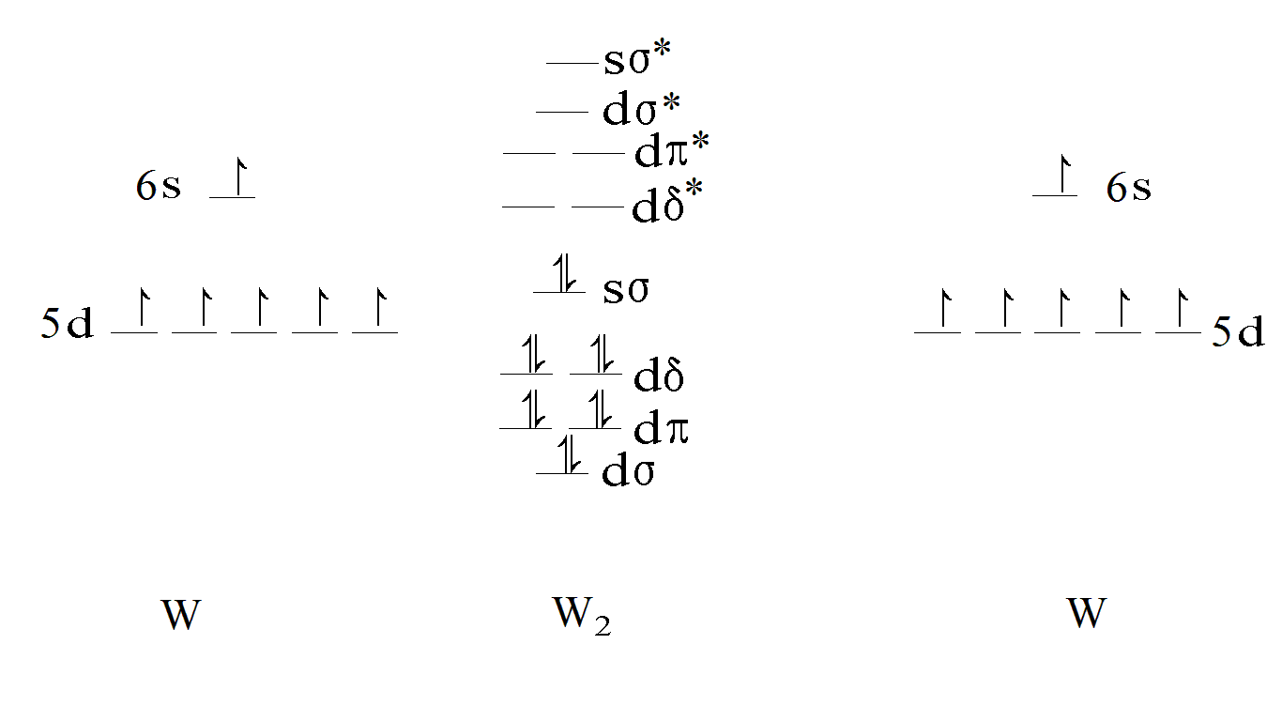
d-orbital bonding in W₂
Tungsten dimer has a sextuple bond!

Slide 34
d-orbital bonding in W₂
≡
W W
≡

Slide 35
Rules for combining atomic orbitals:
Orbitals must be relatively close in energy
Orbitals must overlap significantly
Orbitals must have the same symmetry
That’s it.

Slide 36
Heteronuclear Diatomic Molecules: HF
In HF, the 2s orbital of F is so low in energy it barely combines with anything. (Rule1)
As a result, the 2σ orbital is nearly
purely 2s_{F} in character.
Likewise, the 2p_{x} and 2p_{y} orbitals on F have π symmetry (one nodal plane). The nearest orbital on H with π symmetry is very high in energy (coming from H 2p), and can’t combine. The 1π orbital of HF is almost purely 2p_{F} in character.
The bond is formed from the 1s of H interacting with the 2p_{z} of fluorine, forming bonding (3σ) and antibonding (4σ) orbitals. No g/u designations here, because there’s no center of symmetry.

Slide 37
Polyatomic Molecules: CO₂
Antibonding orbitals
Lone pair orbitals
Bonding orbitals
O 2s-like,
almost core orbitals.
The 1s orbitals are extremely low in energy, way down in the basement!

Slide 38
Let’s examine some of these to understand their bonding/nonbonding/antibonding character: 4σ_{g} orbital
What atomic orbitals have been used to make this molecular orbital?
O C O

Slide 39
Let’s examine some of these to understand their bonding/nonbonding/antibonding character: 4σ_{g} orbital
What atomic orbitals have been used to make this molecular orbital?
Around the O atoms, the orbital looks like a 2p_{z} atomic orbital.
O C O

Slide 40
Let’s examine some of these to understand their bonding/nonbonding/antibonding character: 4σ_{g} orbital
What atomic orbitals have been used to make this molecular orbital?
Around the C atom, the orbital looks like a 2s atomic orbital.
O C O

Slide 41
Let’s examine some of these to understand their bonding/nonbonding/antibonding character: 4σ_{g} orbital
Overall, it looks like a combination of two O 2p_{z} orbitals and a C 2s orbital:
Exploded view
Good overlap makes this a good bonding orbital!
O C O
Bringing the atoms together
Fully overlapped and bonded

Slide 42
What about the 3σ_{u} orbital?
Looking closely at this, this orbital looks like a combination of 2p_{z} orbitals on all three atoms.
O C O
Looks locally like 2p_{z} around the O atom.

Slide 43
What about the 3σ_{u} orbital?
A combination of 2p_{z} orbitals on all three atoms.
Exploded view
Good overlap makes this a good bonding orbital!
O C O
Bringing the atoms together
Looks locally like 2p_{z}
around the C atom, too.
Fully overlapped and bonded

Slide 44
What about the 1π_{u} orbital?
Obviously, this is a combination of all three 2p_{x} orbitals in phase
Exploded view
Good overlap makes this a good bonding orbital!
O C O
Bringing the atoms together
Fully overlapped and bonded

Slide 45
What about the 1π_{g} orbital?
Again, a combination of 2p_{x} orbitals, but only on the O atoms
Exploded view
No contribution on the C atom, means no interaction. This is a nonbonding orbital.
O C O
Bringing the atoms together
Fully overlapped and bonded

Slide 46
What about the 2π_{u} orbital?
Again, a combination of 2p_{x} orbitals, on all three atoms
Exploded view
Uh-oh! The wavefunction changes sign between the atoms! This is an antibonding orbital.
O C O
Bringing the atoms together
Fully overlapped

Slide 47
What about the 5σ_{u} orbital?
Looks like a combination of 2p_{z} orbitals on the O atoms and a 2s orbital on the C atom.
Looks like 2s
on the C atom.
O C O
Looks locally like 2p_{z} around the O atom.

Slide 48
What about the 5σ_{u} orbital?
Looks like a combination of 2p_{z} orbitals on the O atoms and a 2s orbital on the C atom.
Exploded view
This is an antibonding
orbital.
O C O
Bringing the atoms together
Fully overlapped and bonded

Slide 49
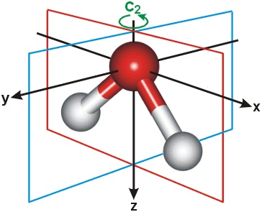
Molecular Orbitals Display the Symmetry of the Molecule
For example, water has two mirror planes (the xz plane and the yz plane)
and a two-fold axis of rotation. All of the molecular orbitals of water are either
symmetric (stay the same) or antisymmetric (change sign) when you apply these
symmetries to them.
Possible Symmetry Types:
Label Rotation xz-plane yz-plane
A₁ Symmetric Symmetric Symmetric
A₂ Symmetric Antisymmetric Antisymmetric
B₁ Antisymmetric Symmetric Antisymmetric
B₂ Antisymmetric Antisymmetric Symmetric
So what do the MOs of water look like?

Slide 50
Polyatomic Molecules: H₂O
Antibonding
Nonbonding
(Lone Pairs)
(b₂, b₁, a₁)
Bonding
a₁
b₂
a₁
The 1a₁ orbital is a nearly pure O 1s orbital, way in the basement! (-520 eV)

Slide 51
More nodes means higher energy:
Consider the polyacetylene: HC₂₀H
H-C≡C-C≡C-C≡C-C≡C-C≡C-C≡C-C≡C-C≡C-C≡C-C≡C-H
Remember De Broglie’s waves?
$$p= \frac{h}{λ}$$
Shorter wavelengths, $λ$, mean higher momentum, p. This means higher kinetic energy because
$$KE= \frac{p^{2}}{2m}$$
These orbitals move to higher energy as their de Broglie wavelength gets shorter!

Slide 52
Thanks to all of you for listening!
All molecular orbital calculations were done using the computational chemistry software purchased from Gaussian, Inc.

